Slide 1
Chapter 4: Advanced SQL

Slide 2
Chapter 4: Advanced SQL
SQL Data Types and Schemas
Integrity Constraints
Authorization
Embedded SQL
Dynamic SQL
Functions and Procedural Constructs**
Recursive Queries**
Advanced SQL Features**

Slide 3
Built-in Data Types in SQL
date: Dates, containing a (4 digit) year, month and date
Example: date ‘2005-7-27’
time: Time of day, in hours, minutes and seconds.
Example: time ‘09:00:30’ time ‘09:00:30.75’
timestamp: date plus time of day
Example: timestamp ‘2005-7-27 09:00:30.75’
interval: period of time
Example: interval ‘1’ day
Subtracting a date/time/timestamp value from another gives an interval value
Interval values can be added to date/time/timestamp values

Slide 4
Build-in Data Types in SQL (Cont.)
Can extract values of individual fields from date/time/timestamp
Example: extract (year from r.starttime)
Can cast string types to date/time/timestamp
Example: cast <string-valued-expression> as date
Example: cast <string-valued-expression> as time

Slide 5
User-Defined Types
create type construct in SQL creates user-defined type
create type Dollars as numeric (12,2) final
create domain construct in SQL-92 creates user-defined domain types
create domain person_name char(20) not null
Types and domains are similar. Domains can have constraints, such as not null, specified on them.

Slide 6
Domain Constraints
Domain constraints are the most elementary form of integrity constraint. They test values inserted in the database, and test queries to ensure that the comparisons make sense.
New domains can be created from existing data types
Example: create domain Dollars numeric(12, 2) create domain Pounds numeric(12,2)
We cannot assign or compare a value of type Dollars to a value of type Pounds.
However, we can convert type as below (cast r.A as Pounds) (Should also multiply by the dollar-to-pound conversion-rate)

Slide 7
Large-Object Types
Large objects (photos, videos, CAD files, etc.) are stored as a large object:
blob: binary large object -- object is a large collection of uninterpreted binary data (whose interpretation is left to an application outside of the database system)
clob: character large object -- object is a large collection of character data
When a query returns a large object, a pointer is returned rather than the large object itself.

Slide 8
Integrity Constraints
Integrity constraints guard against accidental damage to the database, by ensuring that authorized changes to the database do not result in a loss of data consistency.
A checking account must have a balance greater than $10,000.00
A salary of a bank employee must be at least $4.00 an hour
A customer must have a (non-null) phone number

Slide 9
Constraints on a Single Relation
not null
primary key
unique
check (P ), where P is a predicate

Slide 10
Not Null Constraint
Declare branch_name for branch is not null
branch_name char(15) not null
Declare the domain Dollars to be not null
create domain Dollars numeric(12,2) not null

Slide 11
The Unique Constraint
unique ( A₁, A₂, …, A_{m})
The unique specification states that the attributes
A1, A2, … Am form a candidate key.
Candidate keys are permitted to be null (in contrast to primary keys).

Slide 12
The check clause
check (P ), where P is a predicate
Example: Declare branch_name as the primary key for branch and ensure that the values of assets are non-negative.
create table branch (branch_name char(15), branch_city char(30), assets integer, primary key (branch_name), check (assets >= 0))

Slide 13
The check clause (Cont.)
The check clause in SQL-92 permits domains to be restricted:
Use check clause to ensure that an hourly_wage domain allows only values greater than a specified value.
create domain hourly_wage numeric(5,2) constraint value_test check(value > = 4.00)
The domain has a constraint that ensures that the hourly_wage is greater than 4.00
The clause constraint value_test is optional; useful to indicate which constraint an update violated.

Slide 14
Referential Integrity
Ensures that a value that appears in one relation for a given set of attributes also appears for a certain set of attributes in another relation.
Example: If “Perryridge” is a branch name appearing in one of the tuples in the account relation, then there exists a tuple in the branch relation for branch “Perryridge”.
Primary and candidate keys and foreign keys can be specified as part of the SQL create table statement:
The primary key clause lists attributes that comprise the primary key.
The unique key clause lists attributes that comprise a candidate key.
The foreign key clause lists the attributes that comprise the foreign key and the name of the relation referenced by the foreign key. By default, a foreign key references the primary key attributes of the referenced table.

Slide 15
Referential Integrity in SQL – Example
create table customer (customer_name char(20), customer_street char(30), customer_city char(30), primary key (customer_name ))
create table branch (branch_name char(15), branch_city char(30), assets numeric(12,2), primary key (branch_name ))

Slide 16
Referential Integrity in SQL – Example (Cont.)
create table account (account_number char(10), branch_name char(15), balance integer, primary key (account_number), foreign key (branch_name) references branch )
create table depositor (customer_name char(20), account_number char(10), primary key (customer_name, account_number), foreign key (account_number ) references account, foreign key (customer_name ) references customer )

Slide 17
Assertions
An assertion is a predicate expressing a condition that we wish the database always to satisfy.
An assertion in SQL takes the form
create assertion <assertion-name> check <predicate>
When an assertion is made, the system tests it for validity, and tests it again on every update that may violate the assertion
This testing may introduce a significant amount of overhead; hence assertions should be used with great care.
Asserting for all X, P(X) is achieved in a round-about fashion using not exists X such that not P(X)

Slide 18
Assertion Example
Every loan has at least one borrower who maintains an account with a minimum balance or $1000.00
create assertion balance_constraint check (not exists ( select *
from loan where not exists ( select * from borrower, depositor, account where loan.loan_number = borrower.loan_number and borrower.customer_name = depositor.customer_name and depositor.account_number = account.account_number and account.balance >= 1000)))

Slide 19
Assertion Example
The sum of all loan amounts for each branch must be less than the sum of all account balances at the branch.
create assertion sum_constraint check (not exists (select * from branch where (select sum(amount ) from loan where loan.branch_name = branch.branch_name ) >= (select sum (amount ) from account where loan.branch_name = branch.branch_name )))

Slide 20
Authorization
Forms of authorization on parts of the database:
Read - allows reading, but not modification of data.
Insert - allows insertion of new data, but not modification of existing data.
Update - allows modification, but not deletion of data.
Delete - allows deletion of data.
Forms of authorization to modify the database schema (covered in Chapter 8):
Index - allows creation and deletion of indices.
Resources - allows creation of new relations.
Alteration - allows addition or deletion of attributes in a relation.
Drop - allows deletion of relations.

Slide 21
Authorization Specification in SQL
The grant statement is used to confer authorization
grant <privilege list>
on <relation name or view name> to <user list>
<user list> is:
a user-id
public, which allows all valid users the privilege granted
A role (more on this in Chapter 8)
Granting a privilege on a view does not imply granting any privileges on the underlying relations.
The grantor of the privilege must already hold the privilege on the specified item (or be the database administrator).

Slide 22
Privileges in SQL
select: allows read access to relation,or the ability to query using the view
Example: grant users U₁, U₂, and U₃ select authorization on the branch relation:
grant select on branch to U₁, U₂, U₃
insert: the ability to insert tuples
update: the ability to update using the SQL update statement
delete: the ability to delete tuples.
all privileges: used as a short form for all the allowable privileges
more in Chapter 8

Slide 23
Revoking Authorization in SQL
The revoke statement is used to revoke authorization.
revoke <privilege list>
on <relation name or view name> from <user list>
Example:
revoke select on branch from U₁, U₂, U₃
<privilege-list> may be all to revoke all privileges the revokee may hold.
If <revokee-list> includes public, all users lose the privilege except those granted it explicitly.
If the same privilege was granted twice to the same user by different grantees, the user may retain the privilege after the revocation.
All privileges that depend on the privilege being revoked are also revoked.

Slide 24
Embedded SQL
The SQL standard defines embeddings of SQL in a variety of programming languages such as C, Java, and Cobol.
A language to which SQL queries are embedded is referred to as a host language, and the SQL structures permitted in the host language comprise embedded SQL.
The basic form of these languages follows that of the System R embedding of SQL into PL/I.
EXEC SQL statement is used to identify embedded SQL request to the preprocessor
EXEC SQL <embedded SQL statement > END_EXEC
Note: this varies by language (for example, the Java embedding uses # SQL { …. }; )

Slide 25
Example Query
From within a host language, find the names and cities of customers with more than the variable amount dollars in some account.
Specify the query in SQL and declare a cursor for it
EXEC SQL
declare c cursor for select depositor.customer_name, customer_city from depositor, customer, account where depositor.customer_name = customer.customer_name and depositor account_number = account.account_number and account.balance > :amount
END_EXEC

Slide 26
Embedded SQL (Cont.)
The open statement causes the query to be evaluated
EXEC SQL open c END_EXEC
The fetch statement causes the values of one tuple in the query result to be placed on host language variables.
EXEC SQL fetch c into :cn, :cc END_EXEC Repeated calls to fetch get successive tuples in the query result
A variable called SQLSTATE in the SQL communication area (SQLCA) gets set to ‘02000’ to indicate no more data is available
The close statement causes the database system to delete the temporary relation that holds the result of the query.
EXEC SQL close c END_EXEC
Note: above details vary with language. For example, the Java embedding defines Java iterators to step through result tuples.

Slide 27
Updates Through Cursors
Can update tuples fetched by cursor by declaring that the cursor is for update
declare c cursor for select * from account where branch_name = ‘Perryridge’ for update
To update tuple at the current location of cursor c
update account set balance = balance + 100 where current of c

Slide 28
Dynamic SQL
Allows programs to construct and submit SQL queries at run time.
Example of the use of dynamic SQL from within a C program. char * sqlprog = “update account set balance = balance * 1.05 where account_number = ?” EXEC SQL prepare dynprog from :sqlprog; char account [10] = “A-101”; EXEC SQL execute dynprog using :account;
The dynamic SQL program contains a ?, which is a place holder for a value that is provided when the SQL program is executed.

Slide 29
ODBC and JDBC
API (application-program interface) for a program to interact with a database server
Application makes calls to
Connect with the database server
Send SQL commands to the database server
Fetch tuples of result one-by-one into program variables
ODBC (Open Database Connectivity) works with C, C++, C#, and Visual Basic
JDBC (Java Database Connectivity) works with Java

Slide 30
ODBC
Open DataBase Connectivity(ODBC) standard
standard for application program to communicate with a database server.
application program interface (API) to
open a connection with a database,
send queries and updates,
get back results.
Applications such as GUI, spreadsheets, etc. can use ODBC

Slide 31
ODBC (Cont.)
Each database system supporting ODBC provides a "driver" library that must be linked with the client program.
When client program makes an ODBC API call, the code in the library communicates with the server to carry out the requested action, and fetch results.
ODBC program first allocates an SQL environment, then a database connection handle.
Opens database connection using SQLConnect(). Parameters for SQLConnect:
connection handle,
the server to which to connect
the user identifier,
password
Must also specify types of arguments:
SQL_NTS denotes previous argument is a null-terminated string.

Slide 32
ODBC Code
int ODBCexample()
{
RETCODE error;
HENV env; /* environment */
HDBC conn; /* database connection */
SQLAllocEnv(&env);
SQLAllocConnect(env, &conn);
SQLConnect(conn, "aura.bell-labs.com", SQL_NTS, "avi", SQL_NTS, "avipasswd", SQL_NTS);
{ …. Do actual work … }
SQLDisconnect(conn);
SQLFreeConnect(conn);
SQLFreeEnv(env);
}

Slide 33
ODBC Code (Cont.)
Program sends SQL commands to the database by using SQLExecDirect
Result tuples are fetched using SQLFetch()
SQLBindCol() binds C language variables to attributes of the query result
When a tuple is fetched, its attribute values are automatically stored in corresponding C variables.
Arguments to SQLBindCol()
ODBC stmt variable, attribute position in query result
The type conversion from SQL to C.
The address of the variable.
For variable-length types like character arrays,
The maximum length of the variable
Location to store actual length when a tuple is fetched.
Note: A negative value returned for the length field indicates null value
Good programming requires checking results of every function call for errors; we have omitted most checks for brevity.

Slide 34
ODBC Code (Cont.)
Main body of program
char branchname[80]; float balance; int lenOut1, lenOut2; HSTMT stmt;
SQLAllocStmt(conn, &stmt); char * sqlquery = "select branch_name, sum (balance) from account group by branch_name";
error = SQLExecDirect(stmt, sqlquery, SQL_NTS);
if (error == SQL_SUCCESS) { SQLBindCol(stmt, 1, SQL_C_CHAR, branchname , 80, &lenOut1); SQLBindCol(stmt, 2, SQL_C_FLOAT, &balance, 0 , &lenOut2);
while (SQLFetch(stmt) >= SQL_SUCCESS) { printf (" %s %g\n", branchname, balance); } } SQLFreeStmt(stmt, SQL_DROP);

Slide 35
More ODBC Features
Prepared Statement
SQL statement prepared: compiled at the database
Can have placeholders: E.g. insert into account values(?,?,?)
Repeatedly executed with actual values for the placeholders
Metadata features
finding all the relations in the database and
finding the names and types of columns of a query result or a relation in the database.
By default, each SQL statement is treated as a separate transaction that is committed automatically.
Can turn off automatic commit on a connection
SQLSetConnectOption(conn, SQL_AUTOCOMMIT, 0)}
transactions must then be committed or rolled back explicitly by
SQLTransact(conn, SQL_COMMIT) or
SQLTransact(conn, SQL_ROLLBACK)

Slide 36
ODBC Conformance Levels
Conformance levels specify subsets of the functionality defined by the standard.
Core
Level 1 requires support for metadata querying
Level 2 requires ability to send and retrieve arrays of parameter values and more detailed catalog information.
SQL Call Level Interface (CLI) standard similar to ODBC interface, but with some minor differences.

Slide 37
JDBC
JDBC is a Java API for communicating with database systems supporting SQL
JDBC supports a variety of features for querying and updating data, and for retrieving query results
JDBC also supports metadata retrieval, such as querying about relations present in the database and the names and types of relation attributes
Model for communicating with the database:
Open a connection
Create a “statement” object
Execute queries using the Statement object to send queries and fetch results
Exception mechanism to handle errors

Slide 38
JDBC Code
public static void JDBCexample(String dbid, String userid, String passwd)
{
try {
Class.forName ("oracle.jdbc.driver.OracleDriver");
Connection conn = DriverManager.getConnection( "jdbc:oracle:thin:@aura.bell-labs.com:2000:bankdb", userid, passwd);
Statement stmt = conn.createStatement();
… Do Actual Work ….
stmt.close();
conn.close();
}
catch (SQLException sqle) {
System.out.println("SQLException : " + sqle);
}
}

Slide 39
JDBC Code (Cont.)
Update to database
try {
stmt.executeUpdate( "insert into account values ('A-9732', 'Perryridge', 1200)");
} catch (SQLException sqle) {
System.out.println("Could not insert tuple. " + sqle);
}
Execute query and fetch and print results
ResultSet rset = stmt.executeQuery( "select branch_name, avg(balance) from account group by branch_name");
while (rset.next()) {
System.out.println( rset.getString("branch_name") + " " + rset.getFloat(2));
}

Slide 40
JDBC Code Details
Getting result fields:
rs.getString(“branchname”) and rs.getString(1) equivalent if branchname is the first argument of select result.
Dealing with Null values
int a = rs.getInt(“a”);
if (rs.wasNull()) Systems.out.println(“Got null value”);

Slide 41
Procedural Extensions and Stored Procedures
SQL provides a module language
Permits definition of procedures in SQL, with if-then-else statements, for and while loops, etc.
more in Chapter 9
Stored Procedures
Can store procedures in the database
then execute them using the call statement
permit external applications to operate on the database without knowing about internal details
These features are covered in Chapter 9 (Object Relational Databases)

Slide 42
Functions and Procedures
SQL:1999 supports functions and procedures
Functions/procedures can be written in SQL itself, or in an external programming language
Functions are particularly useful with specialized data types such as images and geometric objects
Example: functions to check if polygons overlap, or to compare images for similarity
Some database systems support table-valued functions, which can return a relation as a result
SQL:1999 also supports a rich set of imperative constructs, including
Loops, if-then-else, assignment
Many databases have proprietary procedural extensions to SQL that differ from SQL:1999

Slide 43
SQL Functions
Define a function that, given the name of a customer, returns the count of the number of accounts owned by the customer.
create function account_count (customer_name varchar(20)) returns integer begin declare a_count integer; select count (* ) into a_count from depositor where depositor.customer_name = customer_name return a_count; end
Find the name and address of each customer that has more than one account.
select customer_name, customer_street, customer_city from customer where account_count (customer_name ) > 1

Slide 44
Table Functions
SQL:2003 added functions that return a relation as a result
Example: Return all accounts owned by a given customer
create function accounts_of (customer_name char(20)
returns table ( account_number char(10), branch_name char(15) balance numeric(12,2))
return table (select account_number, branch_name, balance from account A where exists ( select * from depositor D where D.customer_name = accounts_of.customer_name and D.account_number = A.account_number ))

Slide 45
Table Functions (cont’d)
Usage
select * from table (accounts_of (‘Smith’))

Slide 46
SQL Procedures
The author_count function could instead be written as procedure:
create procedure account_count_proc (in title varchar(20), out a_count integer) begin
select count(author) into a_count from depositor where depositor.customer_name = account_count_proc.customer_name
end
Procedures can be invoked either from an SQL procedure or from embedded SQL, using the call statement.
declare a_count integer; call account_count_proc( ‘Smith’, a_count);
Procedures and functions can be invoked also from dynamic SQL
SQL:1999 allows more than one function/procedure of the same name (called name overloading), as long as the number of arguments differ, or at least the types of the arguments differ

Slide 47
Procedural Constructs
Compound statement: begin … end,
May contain multiple SQL statements between begin and end.
Local variables can be declared within a compound statements
While and repeat statements:
declare n integer default 0;
while n < 10 do
set n = n + 1
end while
repeat
set n = n – 1
until n = 0
end repeat

Slide 48
Procedural Constructs (Cont.)
For loop
Permits iteration over all results of a query
Example: find total of all balances at the Perryridge branch declare n integer default 0; for r as select balance from account where branch_name = ‘Perryridge’ do set n = n + r.balance end for

Slide 49
Procedural Constructs (cont.)
Conditional statements (if-then-else) E.g. To find sum of balances for each of three categories of accounts (with balance <1000, >=1000 and <5000, >= 5000)
if r.balance < 1000 then set l = l + r.balance elseif r.balance < 5000 then set m = m + r.balance else set h = h + r.balance end if
SQL:1999 also supports a case statement similar to C case statement
Signaling of exception conditions, and declaring handlers for exceptions
declare out_of_stock condition declare exit handler for out_of_stock begin … .. signal out-of-stock end
The handler here is exit -- causes enclosing begin..end to be exited
Other actions possible on exception

Slide 50
External Language Functions/Procedures
SQL:1999 permits the use of functions and procedures written in other languages such as C or C++
Declaring external language procedures and functions
create procedure account_count_proc(in customer_name varchar(20), out count integer) language C external name ’ /usr/avi/bin/account_count_proc’ create function account_count(customer_name varchar(20)) returns integer language C external name ‘/usr/avi/bin/author_count’

Slide 51
External Language Routines (Cont.)
Benefits of external language functions/procedures:
more efficient for many operations, and more expressive power
Drawbacks
Code to implement function may need to be loaded into database system and executed in the database system’s address space
risk of accidental corruption of database structures
security risk, allowing users access to unauthorized data
There are alternatives, which give good security at the cost of potentially worse performance
Direct execution in the database system’s space is used when efficiency is more important than security

Slide 52
Security with External Language Routines
To deal with security problems
Use sandbox techniques
that is use a safe language like Java, which cannot be used to access/damage other parts of the database code
Or, run external language functions/procedures in a separate process, with no access to the database process’ memory
Parameters and results communicated via inter-process communication
Both have performance overheads
Many database systems support both above approaches as well as direct executing in database system address space

Slide 53
Recursion in SQL
SQL:1999 permits recursive view definition
Example: find all employee-manager pairs, where the employee reports to the manager directly or indirectly (that is manager’s manager, manager’s manager’s manager, etc.) with recursive empl (employee_name, manager_name ) as ( select employee_name, manager_name from manager union select manager.employee_name, empl.manager_name from manager, empl where manager.manager_name = empl.employe_name) select * from empl
This example view, empl, is called the transitive closure of the manager relation

Slide 54
The Power of Recursion
Recursive views make it possible to write queries, such as transitive closure queries, that cannot be written without recursion or iteration.
Intuition: Without recursion, a non-recursive non-iterative program can perform only a fixed number of joins of manager with itself
This can give only a fixed number of levels of managers
Given a program we can construct a database with a greater number of levels of managers on which the program will not work
Computing transitive closure
The next slide shows a manager relation
Each step of the iterative process constructs an extended version of empl from its recursive definition.
The final result is called the fixed point of the recursive view definition.
Recursive views are required to be monotonic. That is, if we add tuples to manger the view contains all of the tuples it contained before, plus possibly more

Slide 55
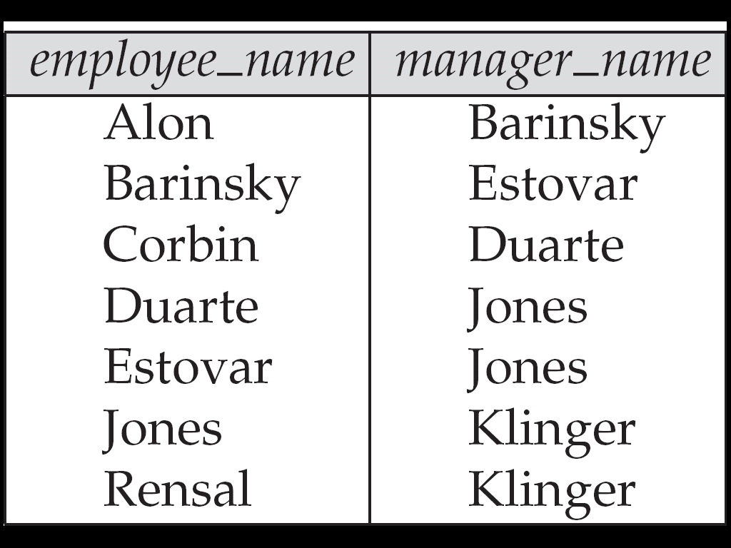
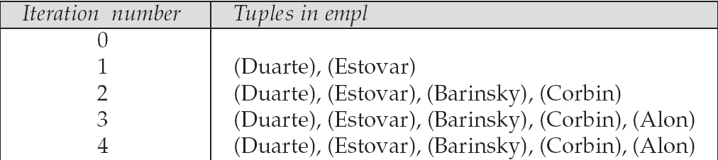
Example of Fixed-Point Computation

Slide 56
Advanced SQL Features**
Create a table with the same schema as an existing table:
create table temp_account like account
SQL:2003 allows subqueries to occur anywhere a value is required provided the subquery returns only one value. This applies to updates as well
SQL:2003 allows subqueries in the from clause to access attributes of other relations in the from clause using the lateral construct:
select C.customer_name, num_accounts from customer C, lateral (select count(*) from account A where A.customer_name = C.customer_name ) as this_customer (num_accounts )

Slide 57
Advanced SQL Features (cont’d)
Merge construct allows batch processing of updates.
Example: relation funds_received (account_number, amount ) has batch of deposits to be added to the proper account in the account relation
merge into account as A using (select * from funds_received as F ) on (A.account_number = F.account_number ) when matched then update set balance = balance + F.amount

Slide 58
End of Chapter

